Slide 1
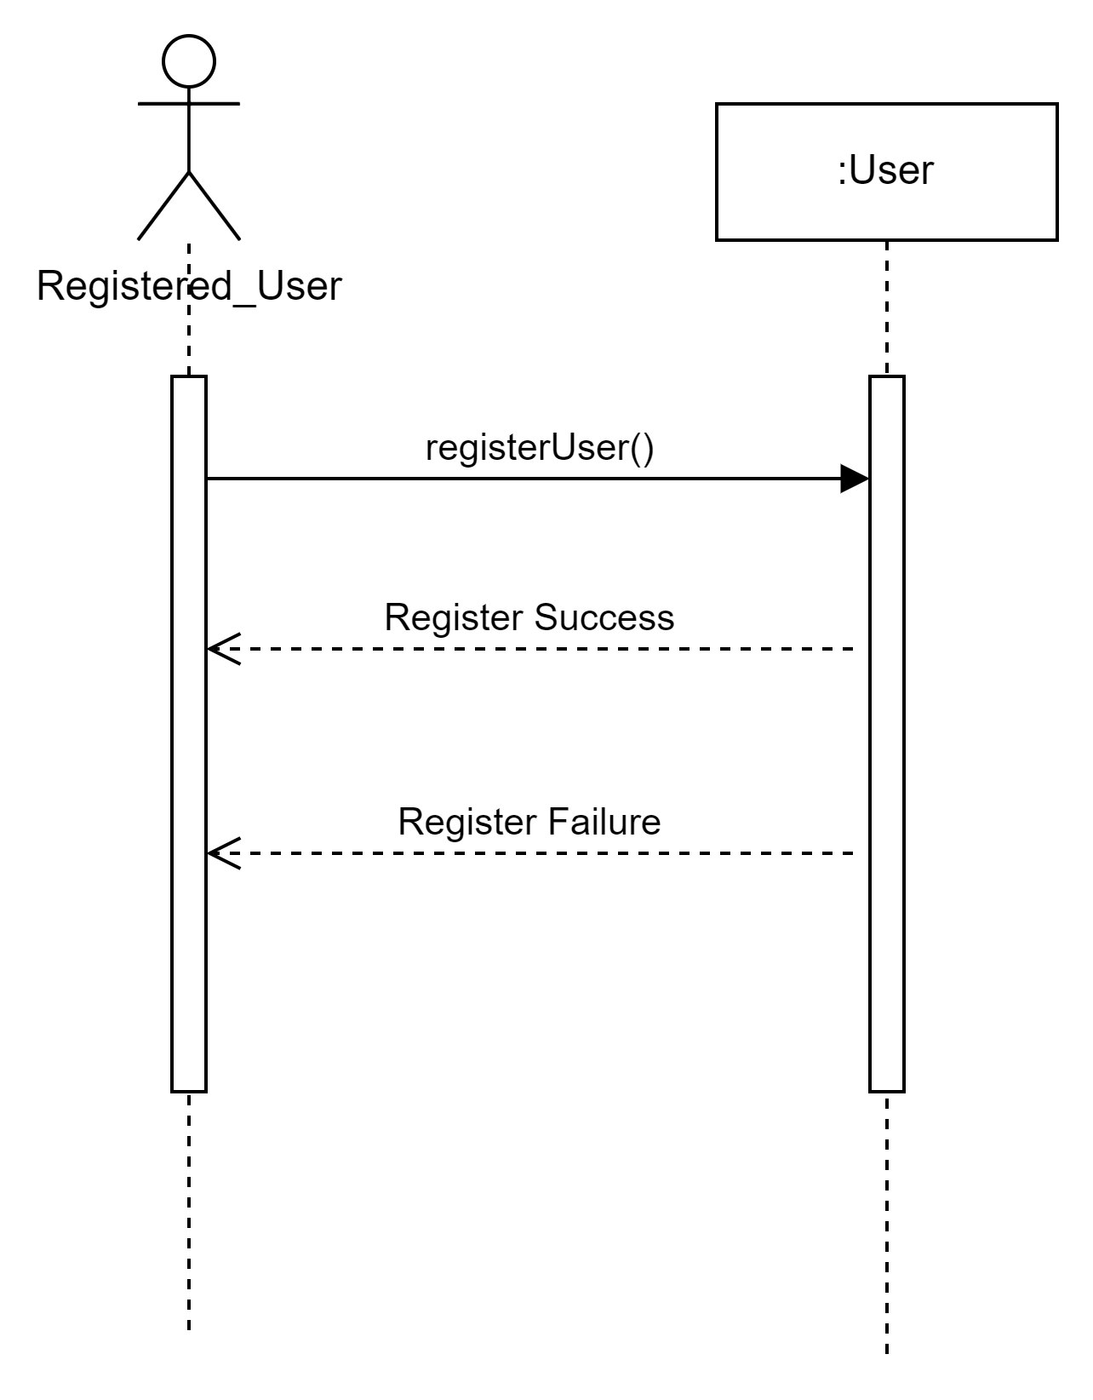
Sequence Diagram - Reviewer
Use Case - 01.01 Create Account
Use Case scenario:
This use case begins when the customer creates an account.
The system checks whether the user posted data and generates user data and tokens if they are sufficient and gives a Registration success/failure message

Slide 2
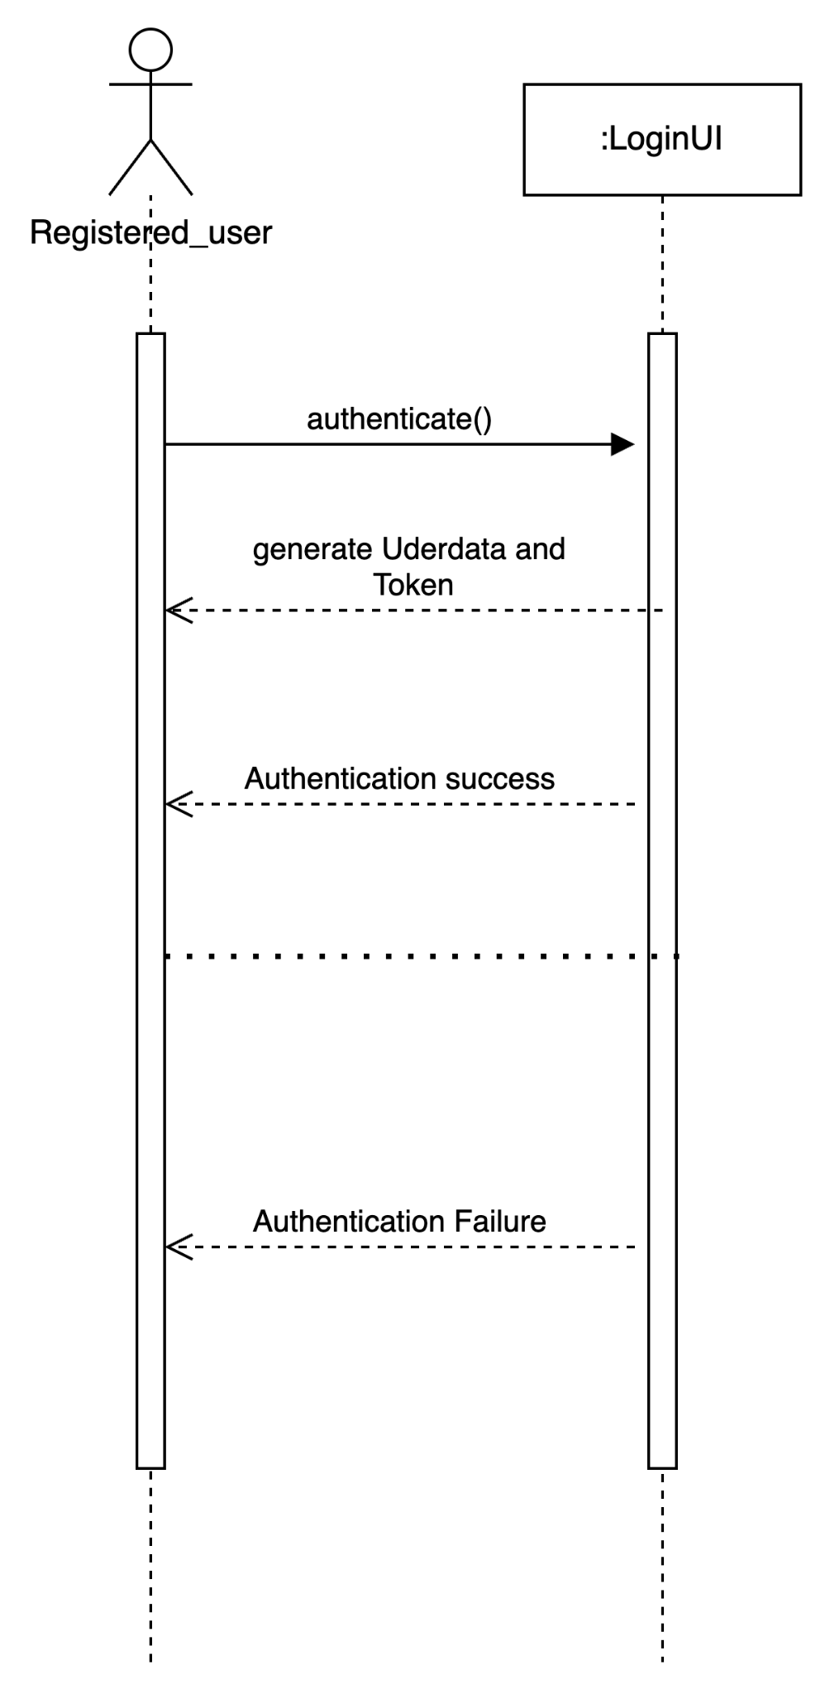
Sequence Diagram - Reviewer
Use Case - 01.02. Sign-In
Use Case Scenario:
This Use case begins when the user tries logging into the system.
System searches the users account credentials before getting authenticated and logged in by the server.
The server authenticates the user by sending the user data and the token details

Slide 3
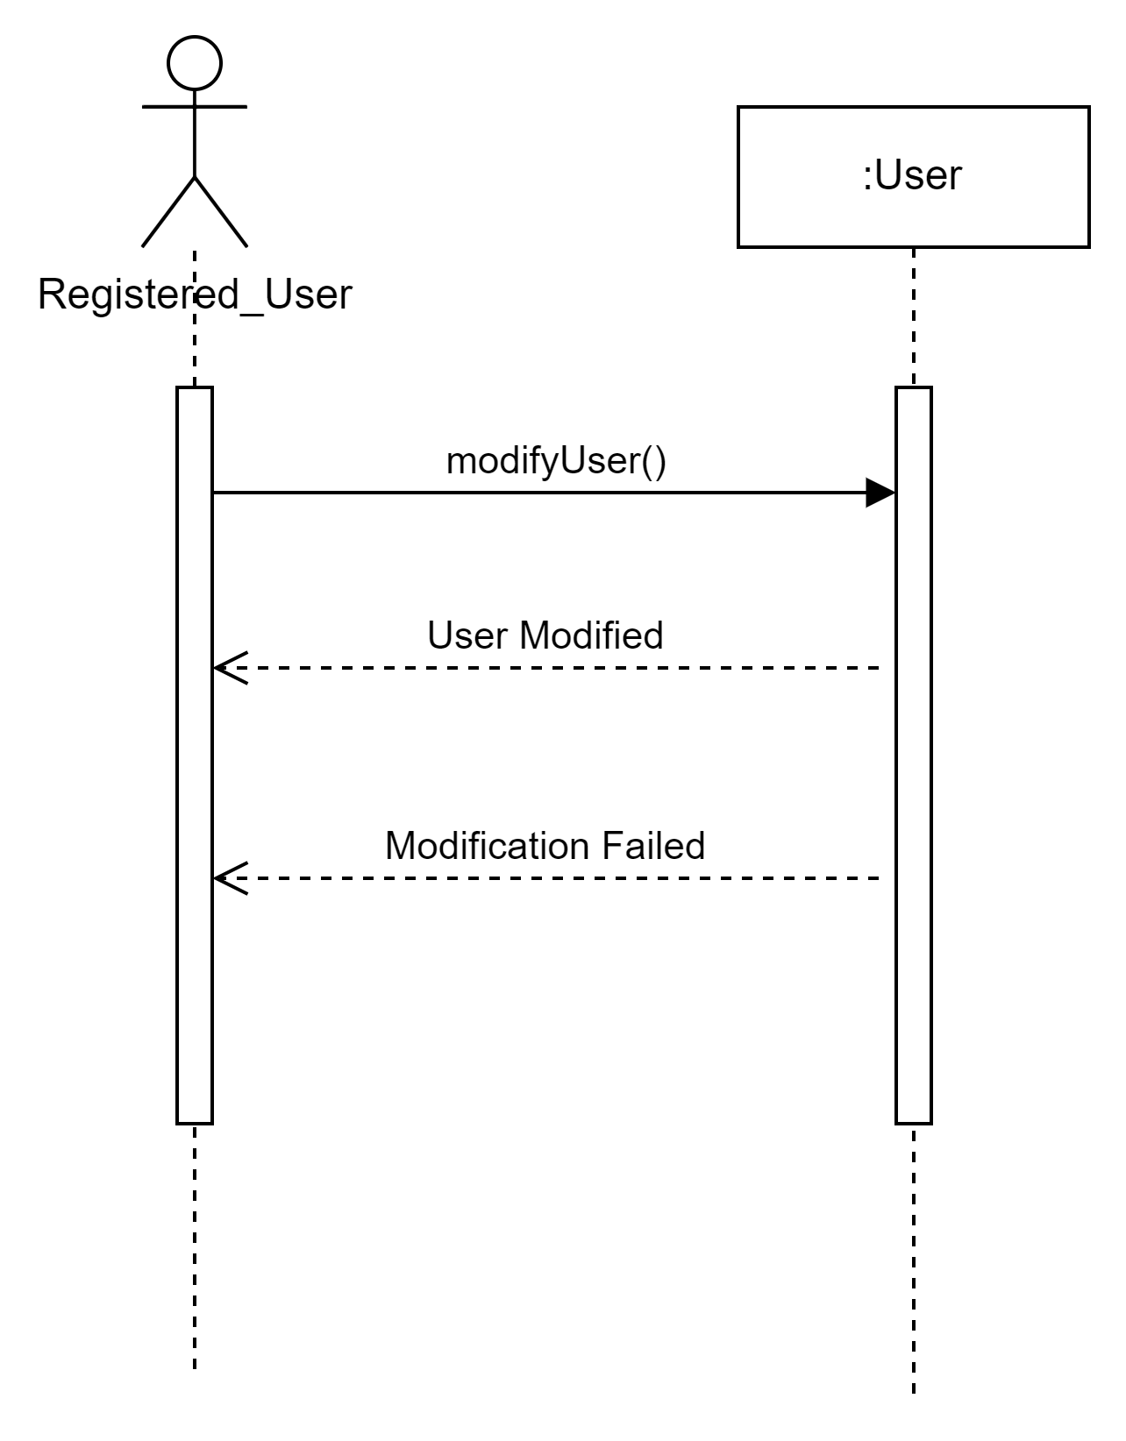
Sequence Diagram - Reviewer
Use Case - 01.03 Modify Account
Use Case scenario:
This Use case begins when the user tries to modify the data the customer creates an account.
The system lets the user to make modifications and gives the modification success/failure message.
The user posted data and generates user data and tokens if they are sufficient and gives a Registration success/failure message.

Slide 4
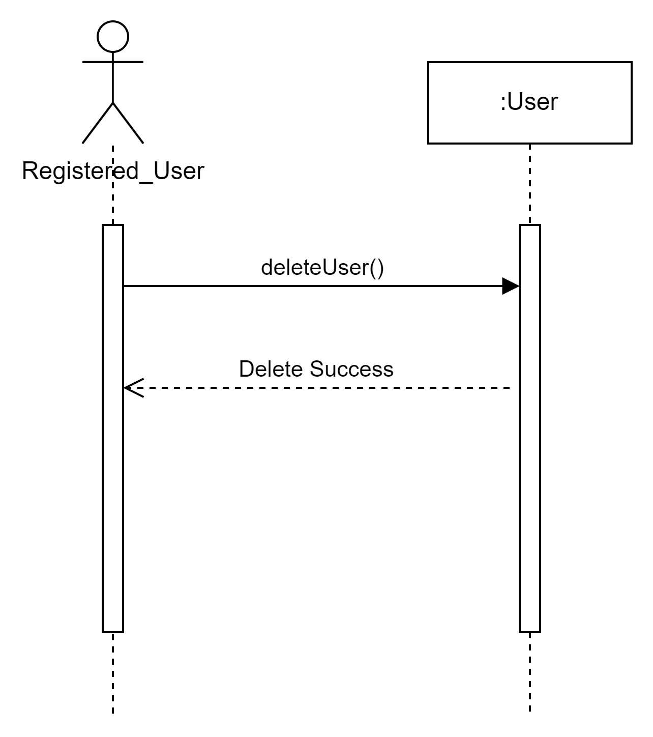
Sequence Diagram - Reviewer
Use Case - 01.04 Delete Account
Use Case scenario:
This use case begins when the user tries to delete the account
The system deletes the account and gives a delete success message.

Slide 5
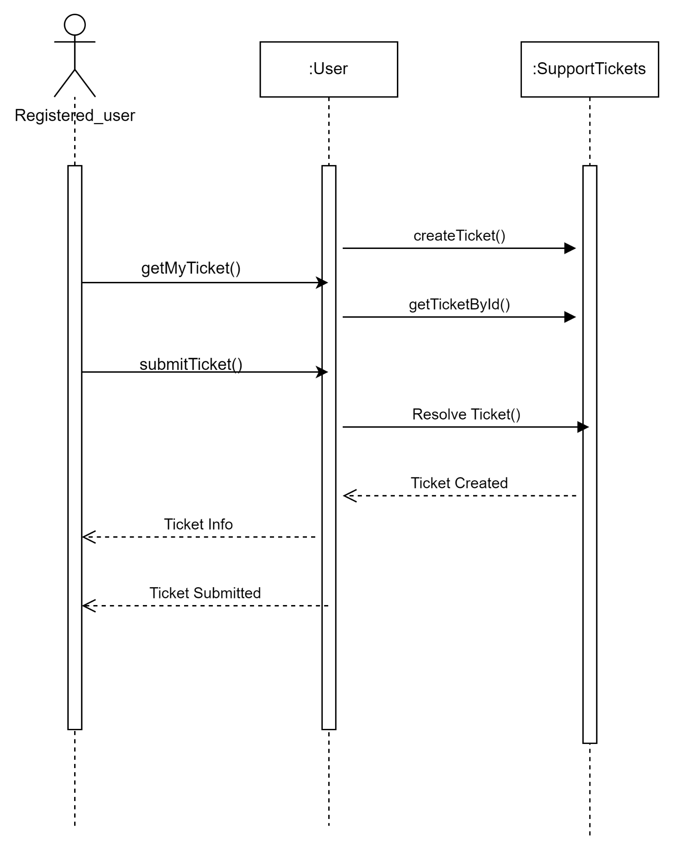
Sequence Diagram - Reviewer
Use Case - 01.06 Provide Customer Support
Use Case Scenario:
This Use case begins when the actor tries to create or modify or get info of the Ticket.
System checks the the status of ticket and send the information about the ticket,and create a new ticket.

Slide 6
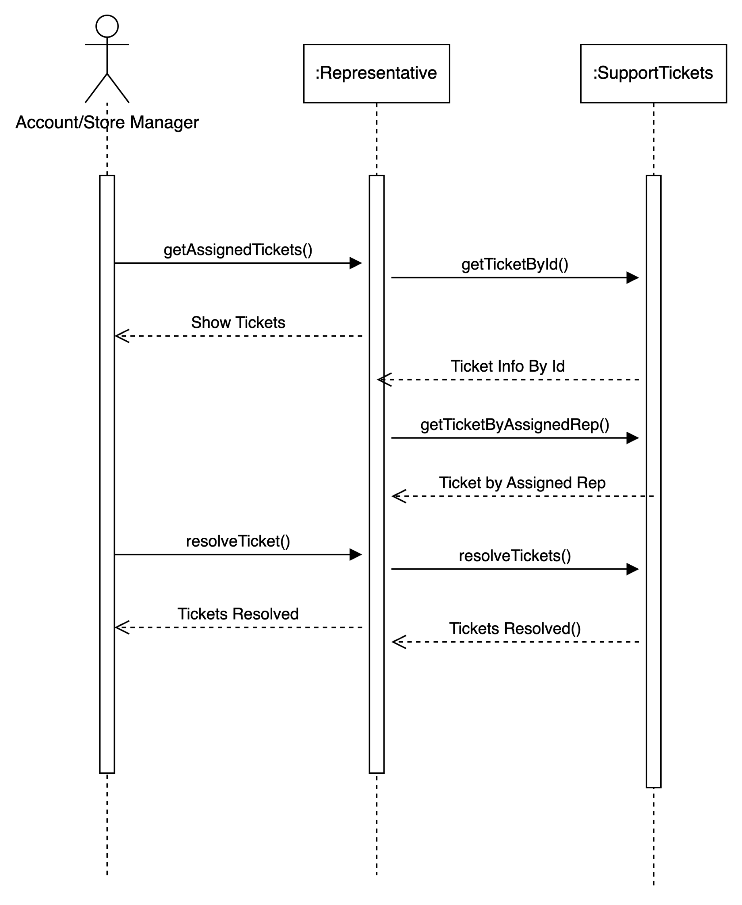
Sequence Diagram - Reviewer
Use Case - 01.06 Provide Customer Support
Use Case Scenario:
This Use case begins when the representative checks for the assigned tickets.
System searches for the assigned tickets and shows the tickets.
The representative then resolves the ticket and ticket will be resolved.

